Slide 1
Instructions for Self-Registration and Training Access-iLearn
General Vendors
V4.0
Changes since last version: updated links to iLearn

Slide 2
Content
Accessing iLearn when already registered
Account and credentials
Accessing iLearn and Registering – first time user
Terms and Conditions
Mandatory Training to use iLearn
Selecting and launching your training
Viewing and printing your certificate
Performing training at a later time
Refresher Training
Support Information

Slide 3
Logging in to iLearn - Already Registered Once logged in, follow instructions from STEP FOUR
Login using this link: iLearn Login Page
Use the same login information with which you created your account
If you have any issue accessing your iLearn account, don’t create a new account.
Check next slide for possible issues and solutions

Slide 4
Logging in to iLearn - Already Registered once logged in, follow instructions from STEP FOUR
Account Deactivated
Contact iLearn support to request reactivation of your account. Reactivation could take up to 2 to 3 business days so plan accordingly.
You have not logged in within 18 months
Your account may have been deactivated
Forgot Password
Please ensure that you enter the correct username email address in order to receive the password reset email
Should be your company email address
Please see last slide for contact details
You used the correct username but have not received a password reset email
Contact iLearn Support

Slide 5
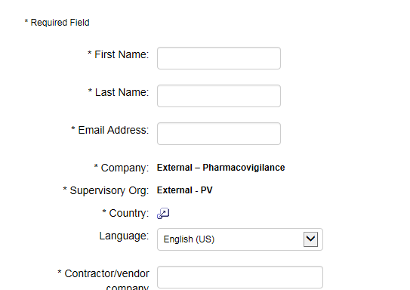
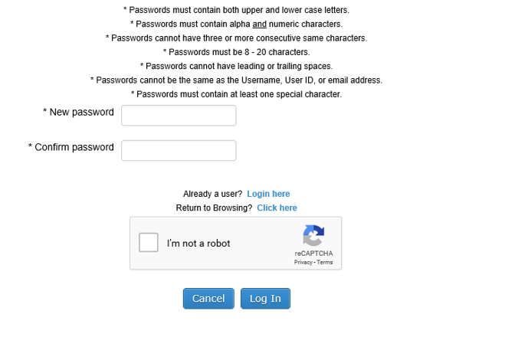
STEP ONE: Registering in iLearn - First Time User
Complete the registration page using this link: iLearn Self-Registration page
Remember your password in order to be able to access iLearn again
Your company email address
Your company name
It is VERY important to complete these fields carefully and to remember what you entered.
You will need the same information whenever you access iLearn again
Very important

Slide 6
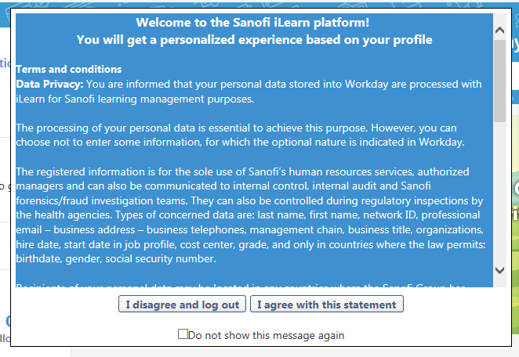
STEP TWO: Terms and Conditions
Select ‘I agree with this statement’

Slide 7
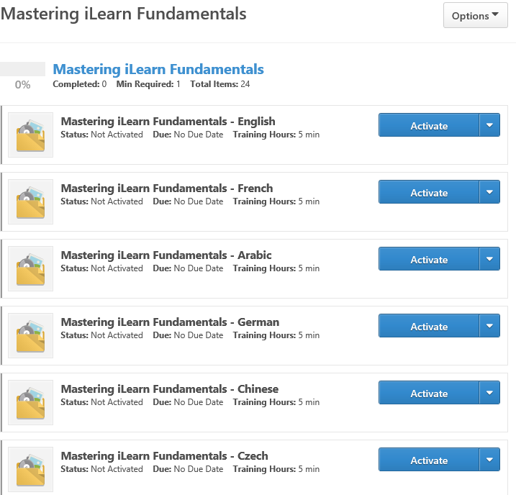
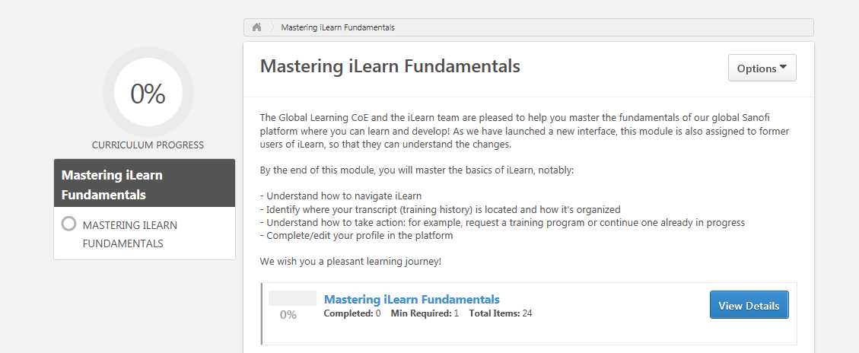
STEP THREE: Mandatory Training to use iLearn
Select ‘View Details’
Select the most appropriate language
Select ‘Activate’
D. Select ‘Launch’
E. Complete the training
F. Mark complete
G. Check that the status is marked ‘Completed’
You need to close iLearn and re-open it before you take the PV training

Slide 8
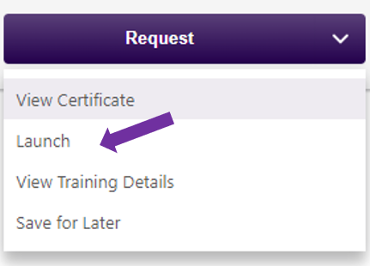
STEP FOUR: Selecting and Launching A Training
Log in using this link: iLearn Login Page
For best results, use the search field at the top right of your screen, click on the magnifying glass, and type in the title as shown:
x
Pharmacovigilance and Product Technical Complaint
Make sure you select the training course corresponding to your activity:
Pharmacovigilance and Product Technical Complaint Reporting Requirements for General Vendors
If your computer is set to your local language by default, the course may display with the translated title
Click on the training to select it, then on ‘Request’, then ‘Launch’ to complete your training

Slide 9
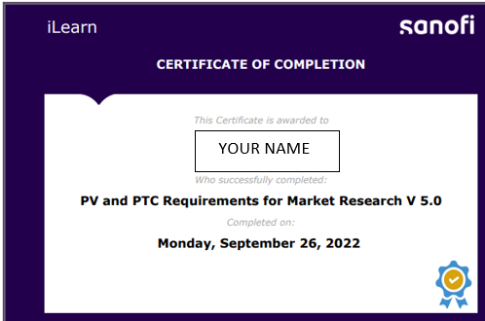
STEP FIVE: Viewing and printing your certificate
Pharmacovigilance and Product Technical Complaint …
Date training completed
Certificates of training completion need to be downloaded and maintained by the Services Providers

Slide 10
Performing training at a later time if already registered
Log in using this link and perform steps above
Search for the training using the search field as described in STEP FOUR
Important information
Refresher Training
Search for the training using the search field as described in STEP FOUR
Do not launch the training from the list of training courses in the completed tab or your certificate will not
update to the new date of training!

Slide 11
Ilearn Support Contact Information
Ilearn User Support:
North America: send an email to : SBS_NA_GLS@sanofi.com
Other Countries:
send an email to : SBS_GLOB_GLS@sanofi.com
Please allow a minimum of two business days for requests to be addressed.

